Slide 1
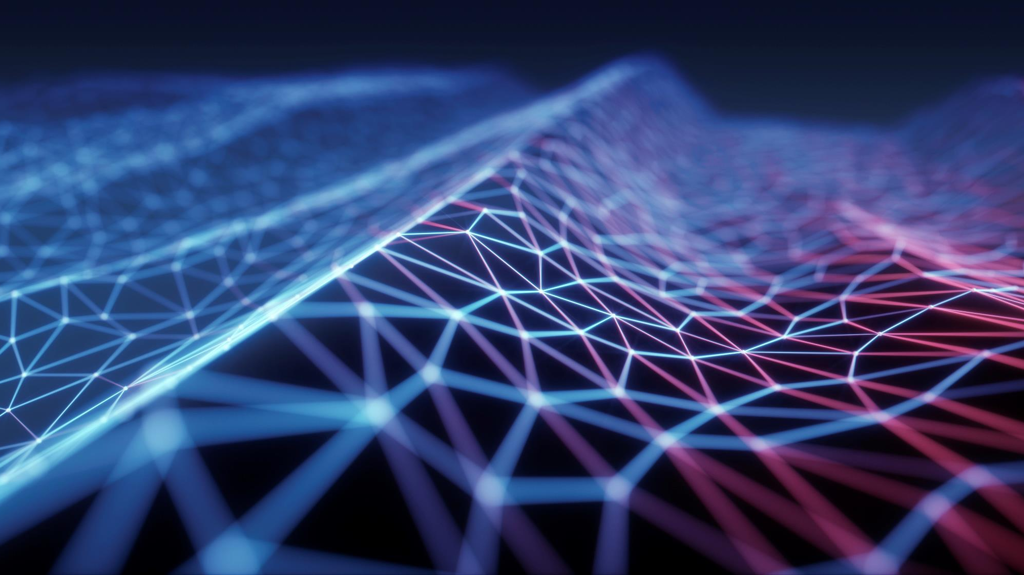
Python
By Aman Tiwari

Slide 2
What is a Programming Language ?
Notes:
In this slide, we'll introduce Python as a high-level, general-purpose, interpreted programming language.

Slide 3
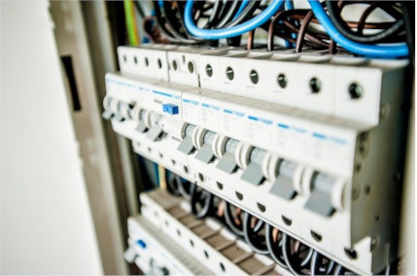
A programming language is a set of instructions that can be used to interact with and control a computer. These languages are used to design websites, create apps, develop operating systems, control spacecraft, and analyze data. Programming languages are necessary because computers can't understand English. Programming languages bridge this gap by helping programmers translate their commands into something that the computer can understand and execute.
Computers are made of many tiny switches that can be either on or off. When a switch is on, it is represented by a 1. When it is off, it is represented by a 0. These 1s and 0s are called bits. Bits are the fundamental language of nearly all computers and every program must be translated into bits before it can be executed by the computer. When 8 bits are grouped together, this is called a byte. A byte can represent a letter, for example, 01100001 represents 'a'. A byte can also represent a control character.
For example, 00000011 signals the end of a piece of text. When representing a number using bits, it can be converted from its normal base 10 representation to binary. This is called binary representation.

Slide 4
What is Python Programming Language ?
Notes:
In this slide, we'll introduce Python as a high-level, general-purpose, interpreted programming language.

Slide 5
High-Level Language
Python is easy to learn due to its high-level nature.
You don't need to understand complex computer details to develop efficient programs in Python.

Slide 6
General-Purpose Language
Python's versatility allows it to be used in various domains:
Web applications
Big data applications
Testing
Automation
Data science, machine learning, and AI
Desktop software
Mobile apps
Even targeted languages like SQL (for relational database queries) can be integrated with Python.

Slide 7
Interpreted Language
Python is interpreted, meaning you write code in a .py file (source code).
An interpreter then translates this code line by line into machine code the computer understands during program execution.
Compiled languages like Java and C# use a compiler that translates the entire source code before execution.

Slide 8
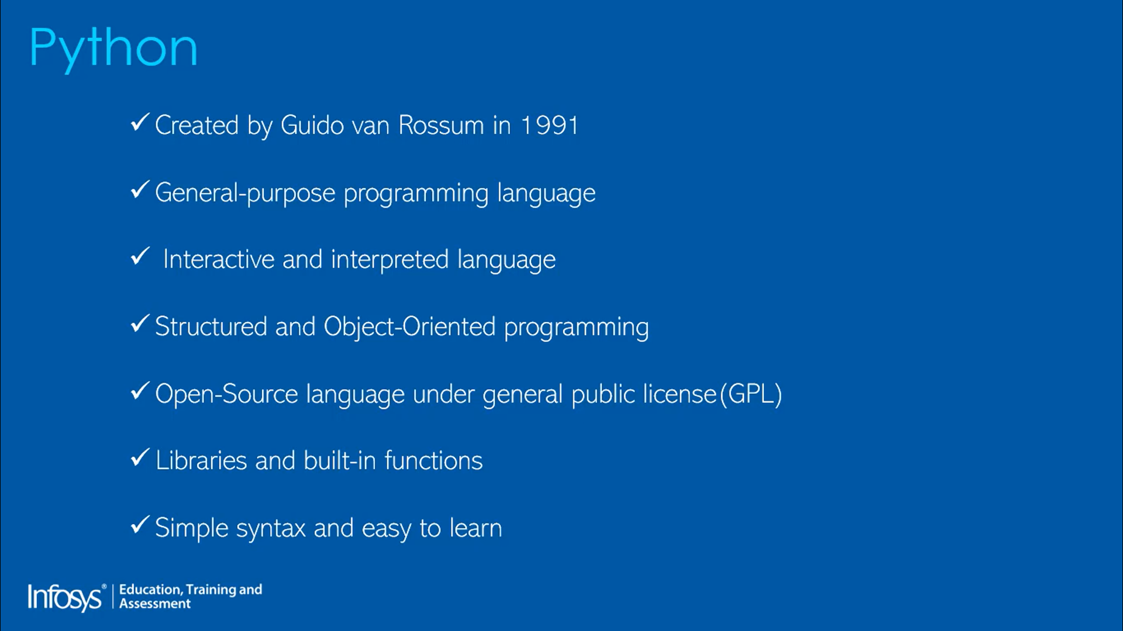

Slide 9
Why Python
Increased Productivity: Python helps solve complex problems with fewer lines of code, enabling faster prototyping.
Solution Across Industries: Python tackles challenges in various fields, from web development to data science.
Easy to Learn: Python's clear and readable syntax makes it beginner-friendly.
Large Ecosystem: Python offers a rich collection of libraries and frameworks for diverse tasks.
Cross-Platform: Python programs run seamlessly on Windows, Linux, and macOS.
Active Community: Whenever you face difficulties, a large and supportive community is available to help.
High Demand: Python developers are sought after in the job market.

Slide 10
Let’s Start with Python
Steps in learning English language:
Alphabets
Words
Sentences
Paragraphs
Book
Steps in learning Python:
Alphabets
Digits
Special
symbols
Constants
Variables
Keywords
Instructions
Program
Software

Slide 11
Environment setup
Desktop
(Binary 0 1 )
Python code
(English)
Interpreter
Text Editor :- Interpreter :- Device (Terminal) :-
eg. Notepad,Notepad++, python official command prompt,
Sublime,atom,brackets interpreter 3.x powershell,Terminal
and etc. etc.

Slide 12
IDE : Integrated Development Environment ( ide = text editor + interpreter + terminal + intellisence etc)
Eg. IDLE,pycharm,Anaconda,Jupyter and etc.
My Combination : VS code + python interpreter + powershell /cmd
https://code.visualstudio.com/download
https://www.python.org/downloads/

Slide 13
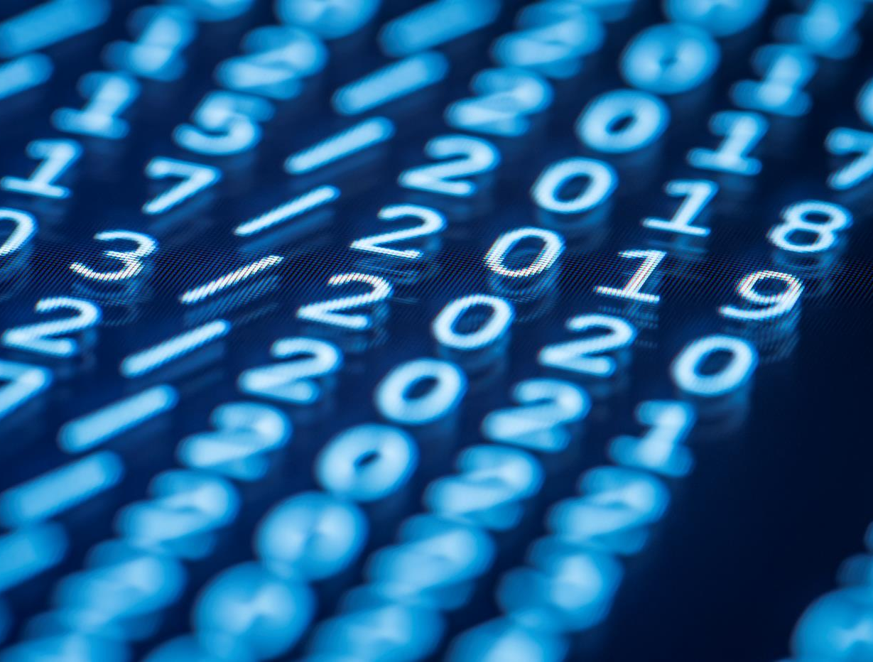
Thank You
amantiwari8861@gmail.com
9891062743

